Slide 1
Regression Analysis
Simple Linear Regression
Nicoleta Serban, Ph.D.
Professor
School of Industrial and Systems Engineering
Example 2: 2000 Presidential Elections in Florida

Slide 2

About This Lesson

Slide 3
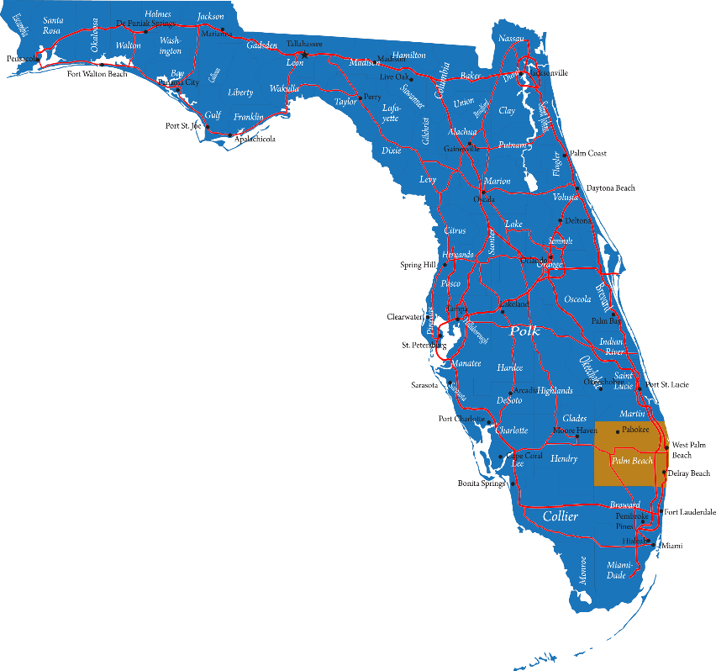


Elections in 2000: Florida
Bush
Gore
Buchanan

Slide 4
Data Example in R
## Read data with read.table R command which is used for reading ASCII files
elections = read.table("elections.txt",header=TRUE)
## Check the data content elections[1:4,]
co lat lon npop whit blac hisp o65 hsed coll inco bush gore brow
1 1 29.7 82.4 198326 74.4 21.8 4.7 9.4 82.7 34.6 19412 34124 47365 658
2 2 30.3 82.3 20761 82.4 16.8 1.5 7.7 64.1 5.7 14859 5610 2392 17
3 3 30.2 85.6 146223 84.2 12.4 2.4 11.9 74.7 15.7 17838 38637 18850 171
4 4 29.9 82.2 24646 76.1 22.9 2.6 11.8 65.0 8.1 13681 5414 3075 28
nade harr hage buch mcre phil moor
1 3226 6 42 263 4 20 21
2 53 0 3 73 0 3 3
3 828 5 18 248 3 18 27
4 84 0 2 65 0 2 3
The data file includes many other variables characterizing the counties. We will focus only on the number of votes in this analysis.

Slide 5
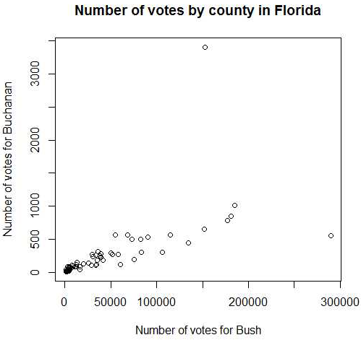
Exploratory Data Analysis in R
### Extract number of votes for each candidates
buch = elections$buch
bush = elections$bush
### Visualize the relationship between number of votes between Buchanan and Bush
plot(bush,buch,xlab="Number of votes for Bush",ylab="Number of votes for Buchanan",
main="Number of votes by county in Florida")
cor(buch,bush)
Linearity Assumption:
The scatterplot shows a strong positive relationship between the number of votes for the two candidates except for two outliers, one corresponding to the Palm Beach county. The correlation is high also (0.625).
Curvature in the relationship – consider transformations

Slide 6
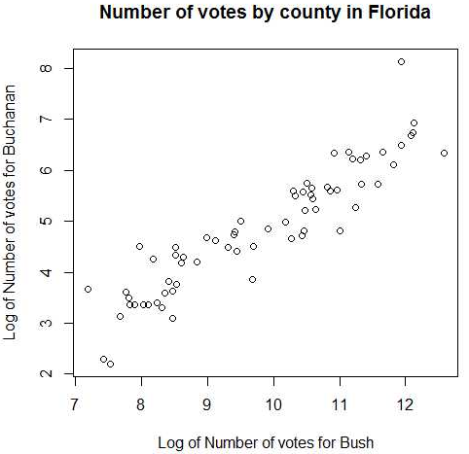
Linearity using Transformation
### Transform both variables using the log-transformation
plot(log(bush),log(buch),xlab="Log of Number of votes for Bush",ylab="Log of Number of votes for Buchanan",
main="Number of votes by county in Florida")
cor(log(bush),log(buch))

Slide 7
Linearity using Transformation
### Transform both variables using the log-transformation
plot(log(bush),log(buch),xlab="Log of Number of votes for Bush",ylab="Log of Number of votes for Buchanan",
main="Number of votes by county in Florida")
cor(log(bush),log(buch))
Linearity Assumption:
The linear relationship has improved with the transformations
The correlation has increased from 0.625 to 0.922
We will perform the regression analysis using the transformed data

Slide 8
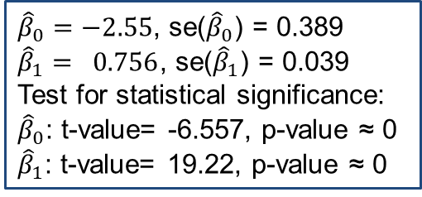
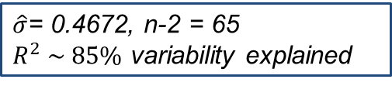
Linear Regression Analysis
model = lm(log(buch)~log(bush))
Coefficients:
Estimate Std. Error t value Pr(>|t|)
(Intercept) -2.55079 0.38903 -6.557 1.04e-08 ***
log(bush) 0.75620 0.03934 19.222 < 2e-16 ***
---
Signif. codes: 0 ‘***’ 0.001 ‘**’ 0.01 ‘*’ 0.05 ‘.’ 0.1 ‘ ’ 1
Residual standard error: 0.4672 on 65 degrees of freedom
Multiple R-squared: 0.8504, Adjusted R-squared: 0.8481
F-statistic: 369.5 on 1 and 65 DF, p-value: < 2.2e-16
${\hat{β}}_{0}=−2.55$, se(${\hat{β}}_{0}$) = 0.389
${\hat{β}}_{1}= 0.756$, se(${\hat{β}}_{1}$) = 0.039
Test for statistical significance:
${\hat{β}}_{0}$: t-value= -6.557, p-value ≈ 0
${\hat{β}}_{1}$: t-value= 19.22, p-value ≈ 0
$\hat{σ}$= 0.4672, n-2 = 65
$R^{2} \sim 85\%$ variability explained

Slide 9
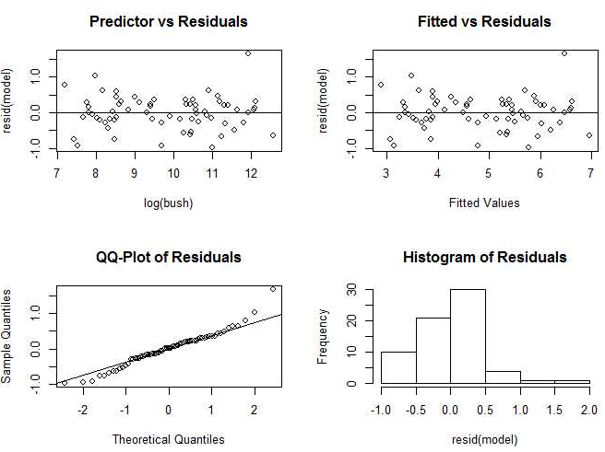
Residual Analysis
## Perform Residual Analysis
par(mfrow=c(2,2))
plot(log(bush),resid(model), main="Predictor vs Residuals”)
abline(0,0)
plot(fitted(model),resid(model),main="Fitted vs Residuals",
xlab="Fitted Values")
abline(0,0)
qqnorm(resid(model),main="QQ-Plot of Residuals")
qqline(resid(model))
hist(resid(model),main="Histogram of Residuals")

Slide 10
Model Interpretation
## Estimated Regression Coefficients
betas = coef(model)
Betas
(Intercept) log(bush)
-2.5507857 0.7561963
## Confidence intervals for the coefficients
confint(model)
2.5 % 97.5 %
(Intercept) -3.3277351 -1.7738363
log(bush) 0.6776289 0.8347638
Interpretation:
As number of log-votes for Bush increase by 1% the expected % increase of log-votes for Buchanan is 0.756.
The minimum % increase is 0.677 and the maximum % increase is 0.834

Slide 11
Is Palm Beach an Outlier?
## Omit Palm Beach
model.red = lm(log(buch[-50])~log(bush[-50]))
summary(model.red)
Coefficients:
Estimate Std. Error t value Pr(>|t|)
(Intercept) -2.31657 0.35470 -6.531 1.23e-08 ***
log(bush[-50]) 0.72960 0.03599 20.271 < 2e-16 ***
## Obtain the predicted vote count for Palm Beach given the fitted model without
new = data.frame(bush = bush[50])
## The difference between predicted on the original scale and the observed vote count
buch[50 ]-exp(predict(model.red,new))
[1] 2809
## Prediction Confidence Interval for log(vote count)
predict(model.red,new,interval='prediction',level=.95)
## Prediction Confidence Interval on the original scale
exp(predict(model.red,new,interval='prediction',level=.95))
fit lwr upr
597.5019 252.738 1412.564
## Is the observed vote count in the prediction interval?
buch[50]
[1] 3407

Slide 12
Is Palm Beach an Outlier?
## Omit Palm Beach
model.red = lm(log(buch[-50])~log(bush[-50]))
summary(model.red)
Coefficients:
Estimate Std. Error t value Pr(>|t|)
(Intercept) -2.31657 0.35470 -6.531 1.23e-08 ***
log(bush[-50]) 0.72960 0.03599 20.271 < 2e-16 ***
## Obtain the predicted vote count for Palm Beach given the fitted model without
new = data.frame(bush = bush[50])
## The difference between predicted on the original scale and the observed vote count
buch[50 ]-exp(predict(model.red,new))
[1] 2809
## Prediction Confidence Interval for log(vote count)
predict(model.red,new,interval='prediction',level=.95)
## Prediction Confidence Interval on the original scale
exp(predict(model.red,new,interval='prediction',level=.95))
fit lwr upr
597.5019 252.738 1412.564
## Is the observed vote count in the prediction interval?
buch[50]
[1] 3407
Interpretation:
The difference between predicted and observed vote count for Bush in the Palm Beach county is 2809.
The upper bound of the prediction confidence interval for the vote count is 1412 which is much lower than the observed vote count, 3407.
While a difference of 2809 votes is not large given the total U.S. votes, this was particularly decisive for the 2000 elections.
Recall that George W. Bush won Florida by a margin of 537 votes.

Slide 13

Summary

